Slide 1
Chapter 3
Chapter 3
Basic Foundations:
Standards, Models, and Language
Network Management: Principles and Practice
© Mani Subramanian 2000
3-1

Slide 2
Chapter 3
Introduction
Standards
  Standards organizations
  Protocol standards of transport layers
  Protocol standards of management
  (application) layer
Management Models
Language
  Notes
Network Management: Principles and Practice
© Mani Subramanian 2000
3-2

Slide 3
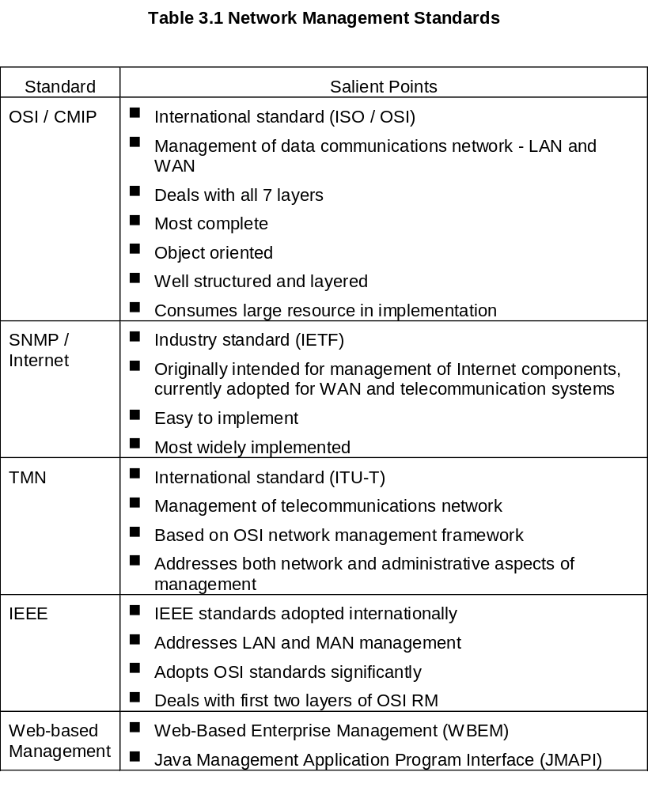
Chapter 3
Network Management: Principles and Practice
© Mani Subramanian 2000
3-3

Slide 4
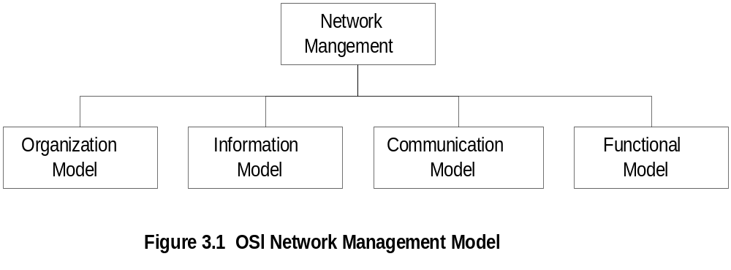
Chapter 3
OSI Architecture and Model
  Notes
Organization
  Network management components
  Functions of components
  Relationships
Information
  Structure of management information (SMI)
    Syntax and semantics
  Management information base (MIB)
    Organization of management information
  Object-oriented
Network Management: Principles and Practice
© Mani Subramanian 2000
3-4

Slide 5
Chapter 3
OSI Architecture and Model
  Notes
Communication
  Transfer syntax with bi-directional messages
  Transfer structure (PDU)
Functions
  Application functions
    Configure components
    Monitor components
    Measure performance
    Secure information
    Usage accounting
Network Management: Principles and Practice
© Mani Subramanian 2000
3-5

Slide 6
Chapter 3
SNMP Architecture and Model
  Notes
Organization
  Same as OSI model
Information
  Same as OSI, but scalar
Communication
  Messages less complex than OSI
  and unidirectional
  Transfer structure (PDU)
Functions
  Application functions
    Operations
    Administration
    Security
Network Management: Principles and Practice
© Mani Subramanian 2000
3-6
Network Management: Principles and Practice
© Mani Subramanian 2000
4-1

Slide 7
Chapter 3
TMN Architecture
Addresses management of telecommunication
networks
Based on OSI model
Superstructure on OSI network
Addresses network, service, and business
management
  Notes
Network Management: Principles and Practice
© Mani Subramanian 2000
3-7

Slide 8
Chapter 3
Organizational Model
Manager
  Sends requests to agents
  Monitors alarms
  Houses applications
  Provides user interface
Agent
  Gathers information from objects
  Configures parameters of objects
  Responds to managers’ requests
  Generates alarms and sends them to
  mangers
Managed object
  Network element that is managed
  Houses management agent
  All objects are not managed / manageable
  Notes
Network Management: Principles and Practice
© Mani Subramanian 2000
3-8

Slide 9
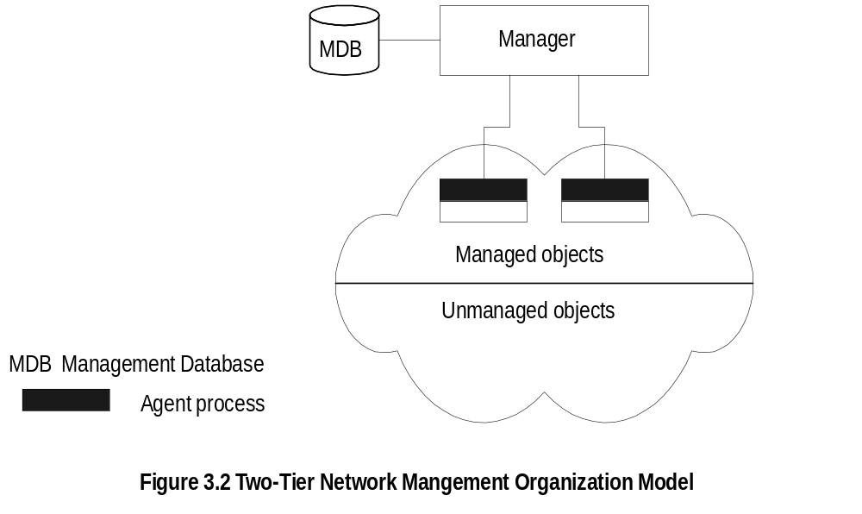
Chapter 3
Two-Tier Model
  Notes
Agent built into network element
Example: Managed hub, managed router
An agent can manage multiple elements
Example: Switched hub, ATM switch
MDB is a physical database
Unmanaged objects are network elements
that are not managed - both physical (unmanaged
hub) and logical (passive elements)
Network Management: Principles and Practice
© Mani Subramanian 2000
3-9

Slide 10
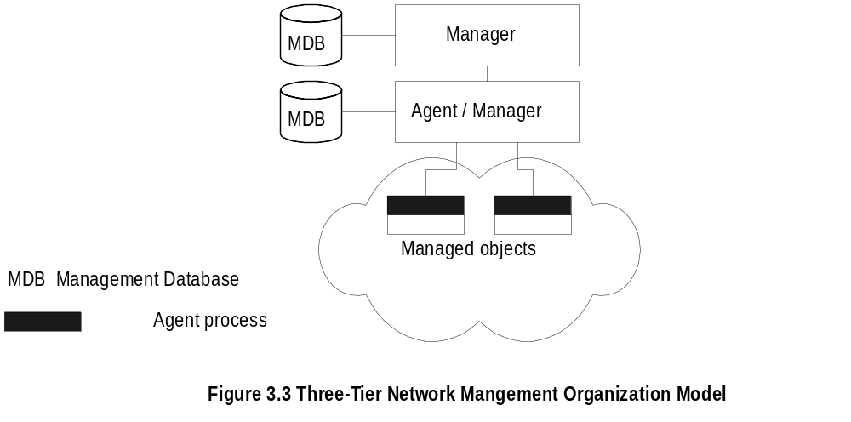
Chapter 3
Three-Tier Model
  Notes
Middle layer plays the dual role
  Agent to the top-level manager
  Manager to the managed objects
Example of middle level: Remote monitoring
agent (RMON)
Network Management: Principles and Practice
© Mani Subramanian 2000
3-10

Slide 11
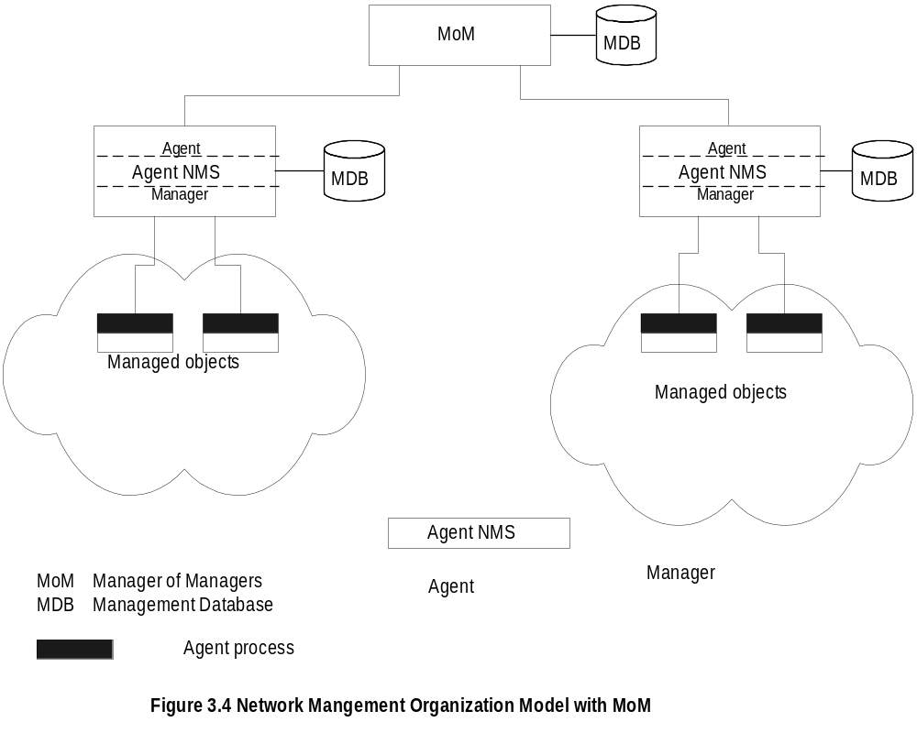
Chapter 3
Manager of Managers
  Notes
Agent NMS manages the domain
MoM presents integrated view of domains
Domain may be geographical, administrative,
vendor-specific products, etc.
Network Management: Principles and Practice
© Mani Subramanian 2000
3-11

Slide 12
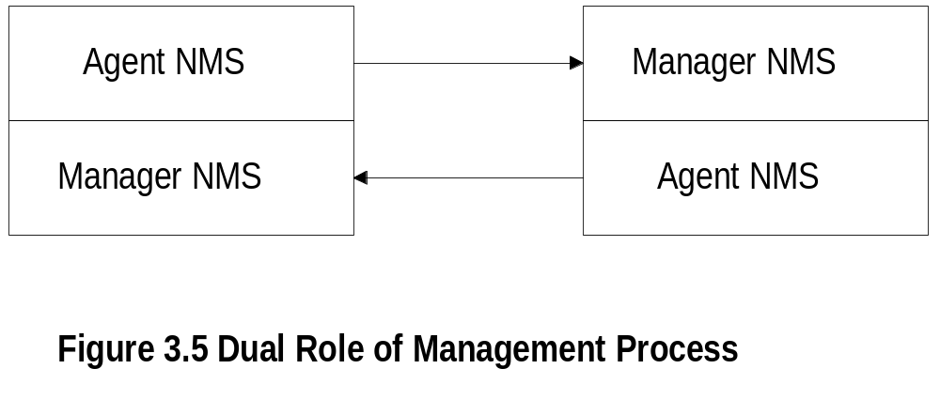
Chapter 3
Peer NMSs
  Notes
Dual role of both NMSs
Network management system acts as peers
Dumbbell architecture discussed in Chapter 1
Notice that the manager and agent functions are
processes and not systems
Network Management: Principles and Practice
© Mani Subramanian 2000
3-12

Slide 13
Chapter 3
Information Model: Analogy
Figure in a book uniquely identified by
  ISBN, Chapter, and Figure number in that
  hierarchical order
ID: {ISBN, chapter, figure}
The three elements above define the syntax
Semantics is the meaning of the three
entities according to Webster’s dictionary
The information comprises syntax and semantics
about an object
  Notes
Network Management: Principles and Practice
© Mani Subramanian 2000
3-13

Slide 14
Chapter 3
Structure of Management Information (SMI)
SMI defines for a managed object
  Syntax
  Semantics
  plus additional information such as status
Example
sysDescr: { system 1 }
Syntax: OCTET STRING
Definition: "A textual description of the entity. "
Access: read-only
Status: mandatory
  Notes
Network Management: Principles and Practice
© Mani Subramanian 2000
3-14

Slide 15
Chapter 3
Management Information Base (MIB)
Information base contains information about objects
Organized by grouping of related objects
Defines relationship between objects
It is NOT a physical database. It is a virtual
database that is compiled into management module
  Notes
Network Management: Principles and Practice
© Mani Subramanian 2000
3-15

Slide 16
Chapter 3
Information Base View: An Analogy
Fulton County library system has many branches
Each branch has a set of books
The books in each branch is a different set
The information base of the county has the
view (catalog) of all books
The information base of each branch has the
catalog of books that belong to that branch.
That is, each branch has its view (catalog) of
the information base
Let us apply this to MIB view
  Notes
Network Management: Principles and Practice
© Mani Subramanian 2000
3-16

Slide 17
Chapter 3
MIB View and Access of an Object
A managed object has many attributes - its
information base
There are several operations that can be
performed on the objects
A user (manager) can view and perform only
certain operations on the object by invoking
the management agent
The view of the object attributes that the agent
perceives is the MIB view
The operation that a user can perform is the
MIB access
  Notes
Network Management: Principles and Practice
© Mani Subramanian 2000
3-17

Slide 18
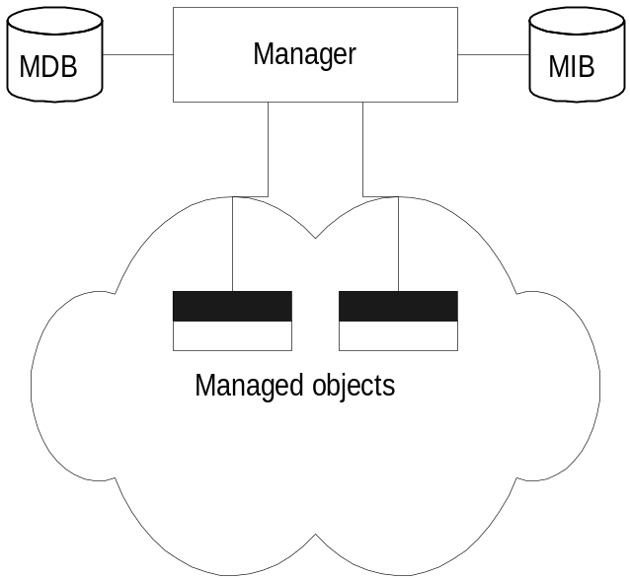
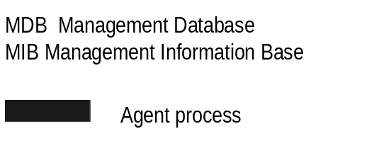
Chapter 3
Management Data Base / Information Base
  Notes
Distinction between MDB and MIB
  MDB physical database; e.g.. Oracle, Sybase
  MIB virtual database; schema compiled into
  management software
An NMS can automatically discover a managed
object, such as a hub, when added to the network
The NMS can identify the new object as hub only
after the MIB schema of the hub is compiled into
NMS software
Network Management: Principles and Practice
© Mani Subramanian 2000
3-18

Slide 19
Chapter 3
Managed Object
Managed objects can be
  Network elements (hardware, system)
    hubs, bridges, routers, transmission facilities
  Software (non-physical)
    programs, algorithms
  Administrative information
    contact person, name of group of objects
    (IP group)
  Notes
Network Management: Principles and Practice
© Mani Subramanian 2000
3-19

Slide 20
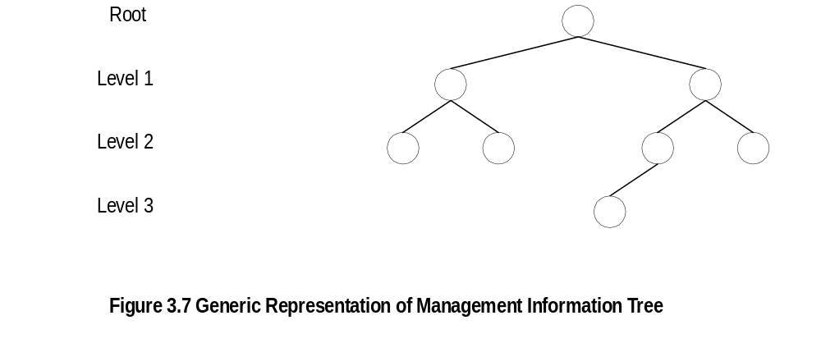
Chapter 3
Management Information Tree
  Notes
Network Management: Principles and Practice
© Mani Subramanian 2000
3-20

Slide 21
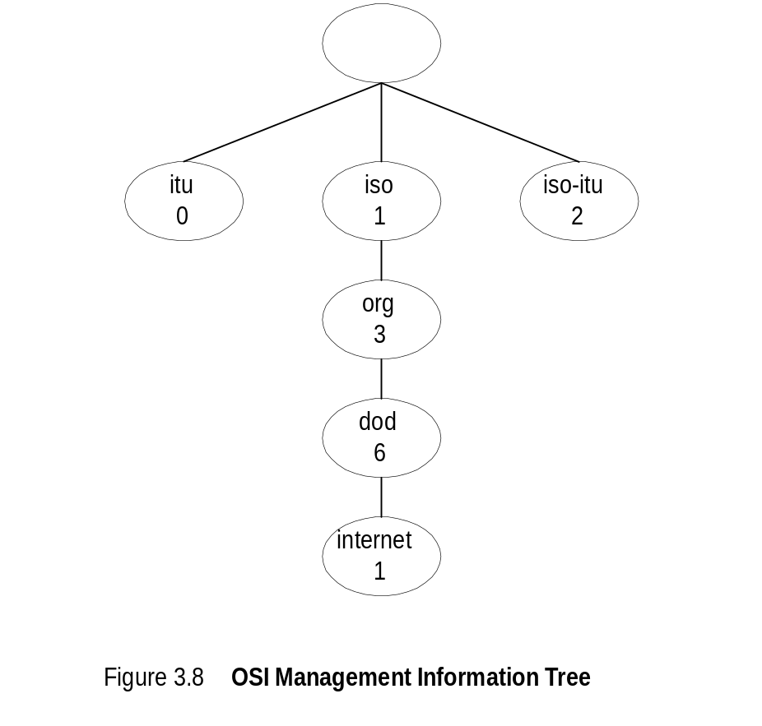
Chapter 3
OSI Management Information Tree
  Notes
iso International Standards Organization
itu International Telecommunications Union
dod Department of Defense
Designation:
  iso 1
  org 1.3
  dod 1.3.6
  internet 1.3.6.1
Network Management: Principles and Practice
© Mani Subramanian 2000
3-21

Slide 22
Chapter 3
Object Type and Instance
Type
  Name
  Syntax
  Definition
  Status
  Access
Instance
  Notes
Example of a circle
  “circle” is syntax
  Semantics is definition from dictionary”
  “A plane figure bounded by a single curved
  line, every point of which is of equal distance
  from the center of the figure.”
Analogy of nursery school
Network Management: Principles and Practice
© Mani Subramanian 2000
3-22

Slide 23
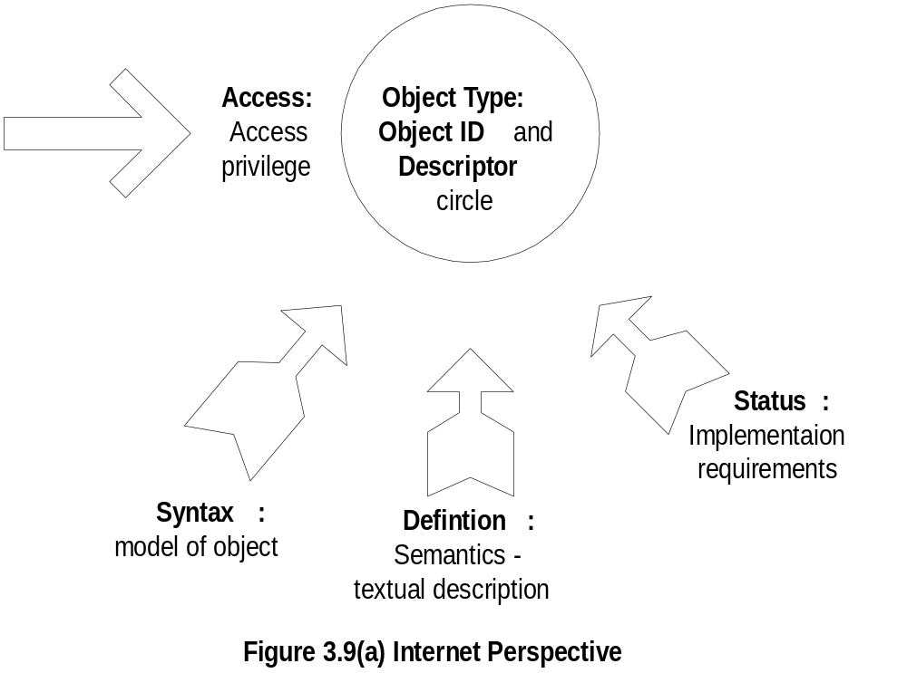
Chapter 3
Managed Object:
Internet Perspective
  Notes
    object ID unique ID
    and descriptor and name for the object
    syntax used to model the object
    access access privilege to a managed object
    status implementation requirements
    definition textual description of the semantics of object type
Network Management: Principles and Practice
© Mani Subramanian 2000
3-23

Slide 24
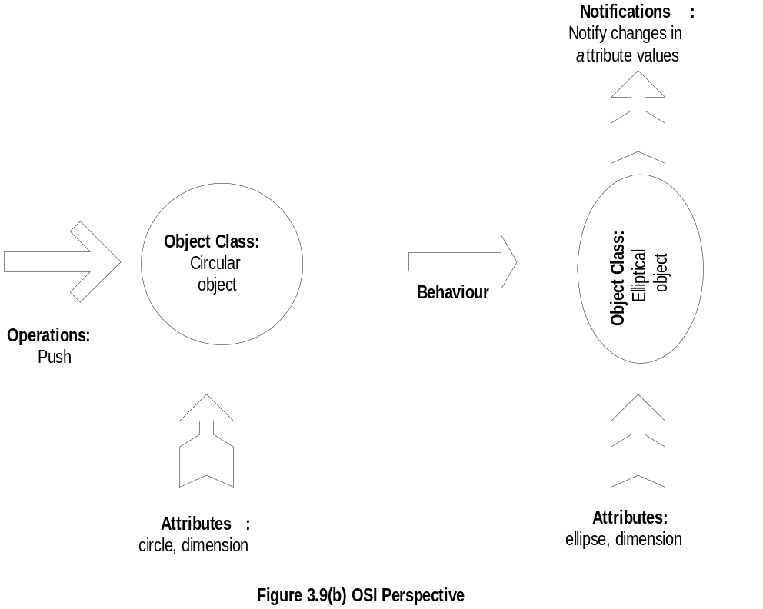
Managed Object:
OSI Perspective
Chapter 3
  Notes
    object class managed object
    attributes attributes visible at its boundary
    operations operations which may be applied to it
    behaviour behaviour exhibited by it in response to operation
    notifications notifications emitted by the object
Network Management: Principles and Practice
© Mani Subramanian 2000
3-24

Slide 25
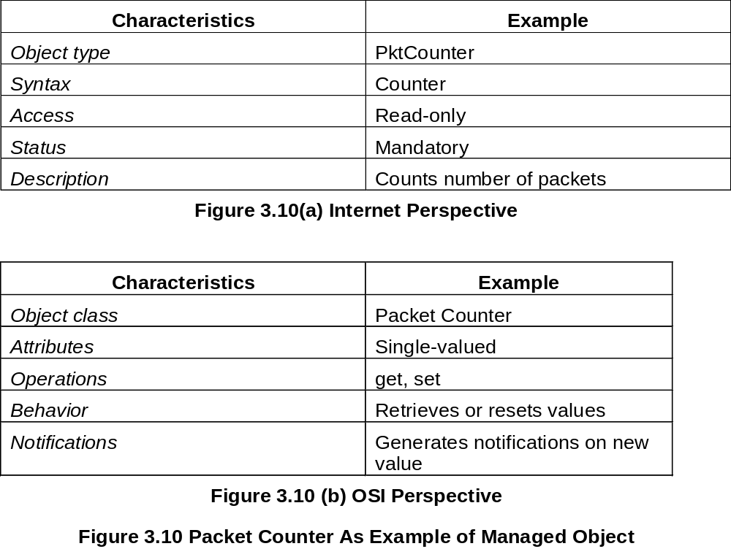
Chapter 3
Packet Counter Example
  Notes
Network Management: Principles and Practice
© Mani Subramanian 2000
3-25

Slide 26
Chapter 3
Internet Vs OSI Managed Object
Scalar object in Internet Vs Object-oriented
approach in OSI
OSI characteristics of operations, behaviour, and
notification are part of communication model in
Internet: get/set and response/alarm
Internet syntax is absorbed as part of OSI attributes
Internet access is part of OSI security model
Internet status is part of OSI conformance application
OSI permits creation and deletion of objects;
Internet does not: Enhancement in SNMPv2
  Notes
Network Management: Principles and Practice
© Mani Subramanian 2000
3-26

Slide 27
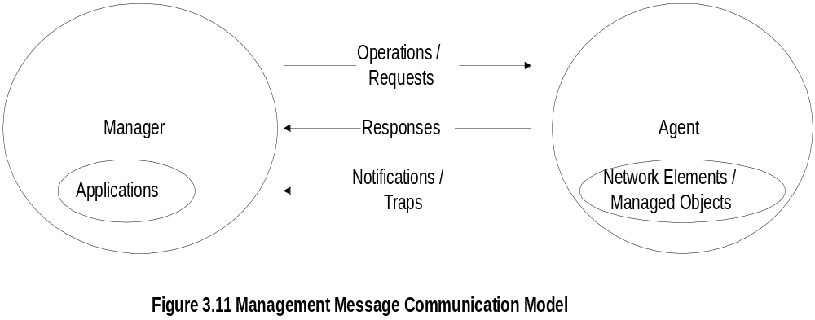
Chapter 3
Mgmt. Communication Model
  Notes
In Internet requests/responses, in OSI operations
In Internet traps and notifications (SNMPv2),
in OSI notifications
Network Management: Principles and Practice
© Mani Subramanian 2000
3-27

Slide 28
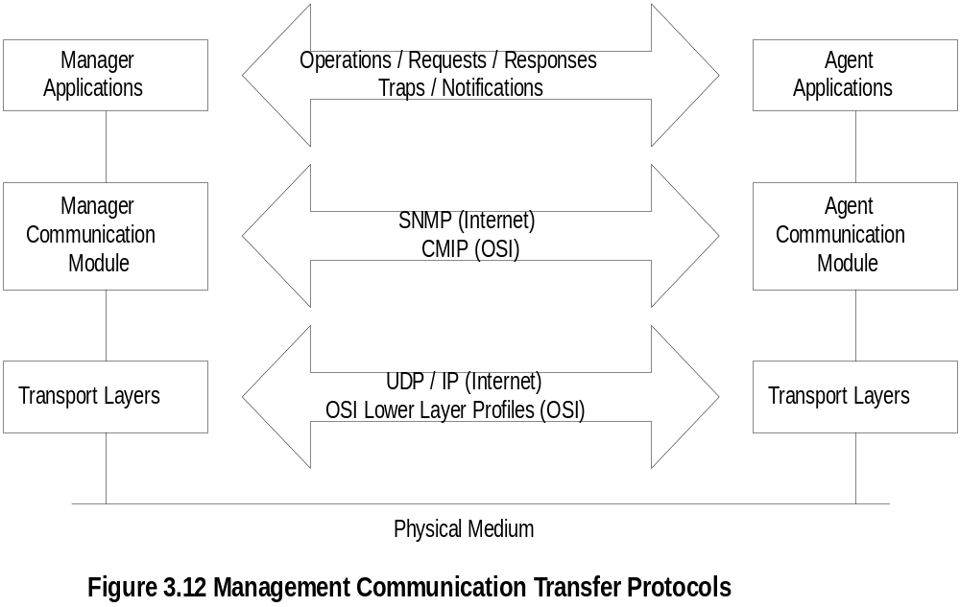
Chapter 3
Transfer Protocols
  Notes
Internet is based on SNMP; OSI is based on CMIP
OSI uses CMISE (Common Management Information
Service Element) application with CMIP
OSI specifies both c-o and connectionless transport
protocol; SNMPv2 extended to c-o, but rarely used
Network Management: Principles and Practice
© Mani Subramanian 2000
3-28

Slide 29
Chapter 3
Abstract Syntax Notation One
ASN.1 is more than a syntax; it’s a language
Addresses both syntax and semantics
Two type of syntax
  Abstract syntax: set of rules that specify
  data type and structure for information storage
  Transfer syntax: set of rules for communicating
  information between systems
Makes application layer protocols
independent of lower layer protocols
Can generate machine-readable code: Basic
Encoding Rules (BER) is used in management
modules
  Notes
Network Management: Principles and Practice
© Mani Subramanian 2000
3-29

Slide 30
Chapter 3
Backus-Nauer Form (BNF)
Definition:
<name> ::= <definition>
Rules:
<digit> ::= 0|1|2|3|4|5|6|7|8|9
<number> ::= <number> | <digit> <number>
<op> ::= +|-|x|/
<SAE> ::= <number>|<SAE>|<SAE><op><SAE>
Example:
9 is primitive 9
19 is construct of 1 and 9
619 is construct of 6 and 19
  Notes
BNF is used for ASN.1 constructs
Constructs developed from primitives
The above example illustrates how numbers are constructed from the primitive <digit>
Simple Arithmetic Expression entity (<SAE>) is constructed from the primitives <digit> and <op>
Network Management: Principles and Practice
© Mani Subramanian 2000
3-30

Slide 31
Chapter 3
Simple Arithmetic Expression
<SAE> ::= <number> | <SAE><op><number>
Example: 26 = 13 x 2
Constructs and primitives
  Notes
Network Management: Principles and Practice
© Mani Subramanian 2000
3-31

Slide 32
Chapter 3
Type and Value
Assignments
  <BooleanType> ::= BOOLEAN
  <BooleanValue> ::= TRUE | FALSE
ASN.1 module is a group of assignments
person-name Person-Name::=
{
    first "John",
middle "I",
last "Smith"
}
  Notes
Network Management: Principles and Practice
© Mani Subramanian 2000
3-32

Slide 33
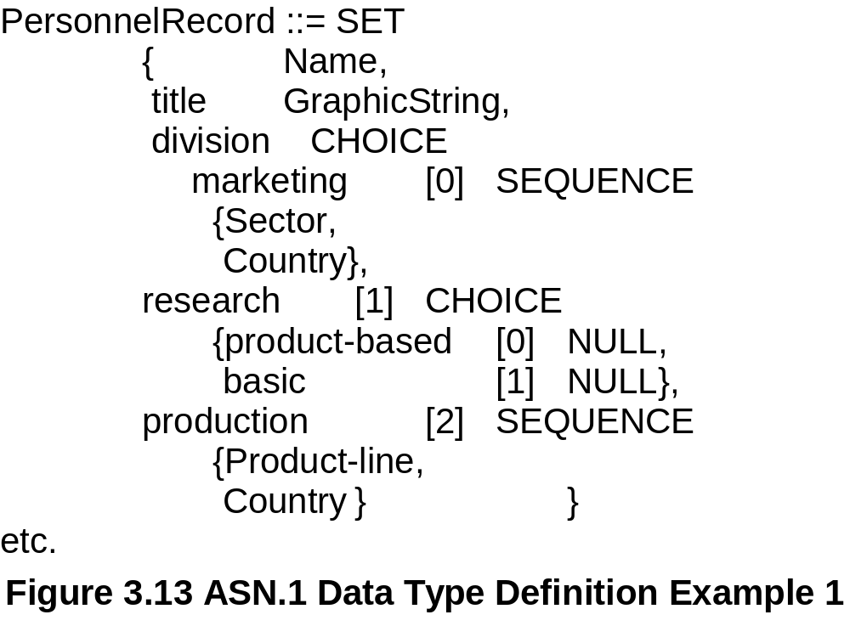
Chapter 3
Data Type: Example 1
  Notes
Module name starts with capital letters
Data types:
  Primitives: NULL, GraphicString
  Constructs
    Alternatives : CHOICE
    List maker: SET, SEQUENCE
    Repetition: SET OF, SEQUENCE OF:
Difference between SET and SEQUENCE
Network Management: Principles and Practice
© Mani Subramanian 2000
3-33

Slide 34
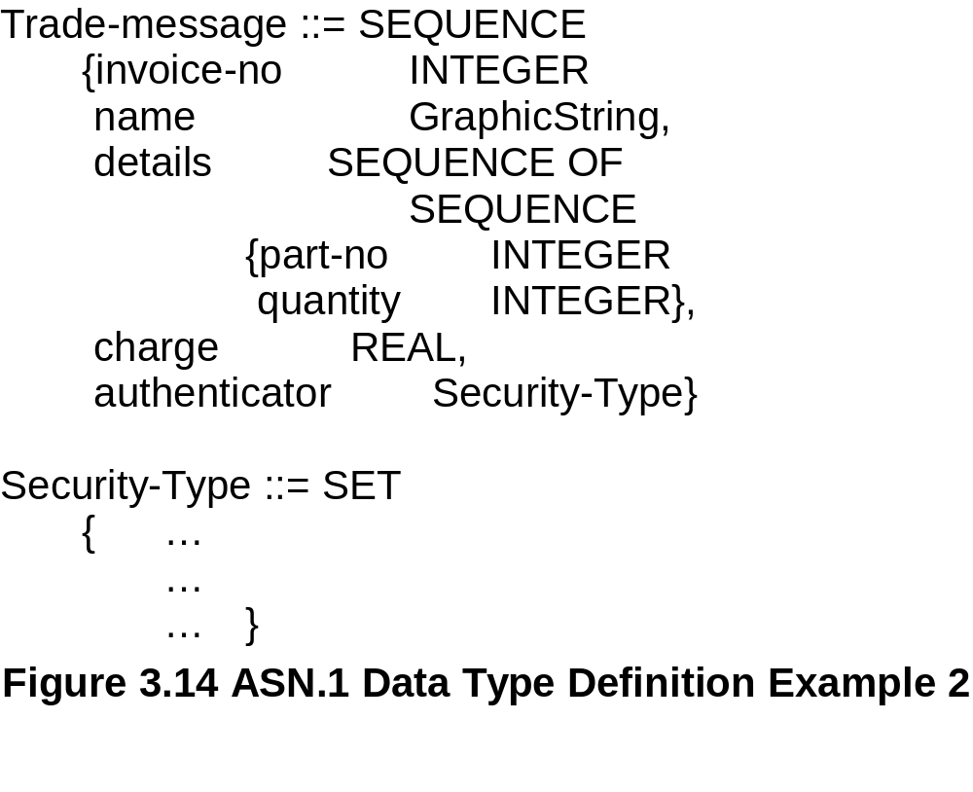
Chapter 3
Data Type: Example 2
  Notes
SEQUENCE OF SEQUENCE makes tables of rows
Network Management: Principles and Practice
© Mani Subramanian 2000
3-34

Slide 35
Chapter 3
ASN.1 Symbols
Symbol Meaning
::= Defined as
| or, alternative, options of a list
- Signed number
-- Following the symbol are comments
{} Start and end of a list
[] Start and end of a tag
() Start and end of subtype
.. Range
  Notes
Network Management: Principles and Practice
© Mani Subramanian 2000
3-35

Slide 36
Chapter 3
Keyword Examples
CHOICE
SET
SEQUENCE
OF
NULL
  Notes
Keywords are in all UPPERCASE letters
Network Management: Principles and Practice
© Mani Subramanian 2000
3-36

Slide 37
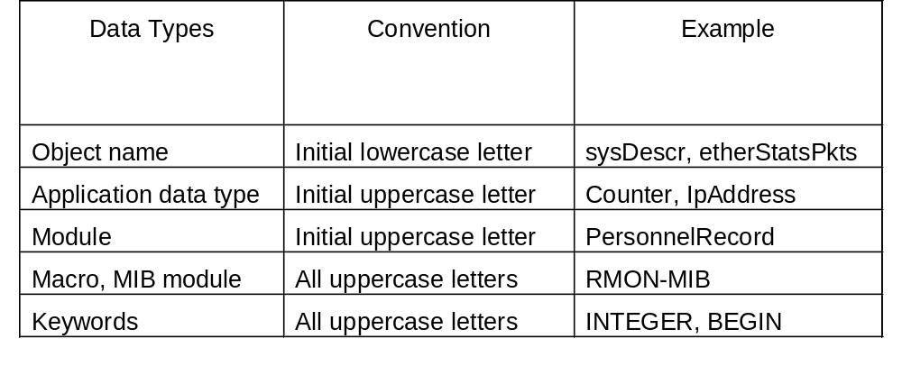
Chapter 3
ASN.1 Data Type Conventions
  Notes
Network Management: Principles and Practice
© Mani Subramanian 2000
3-37

Slide 38
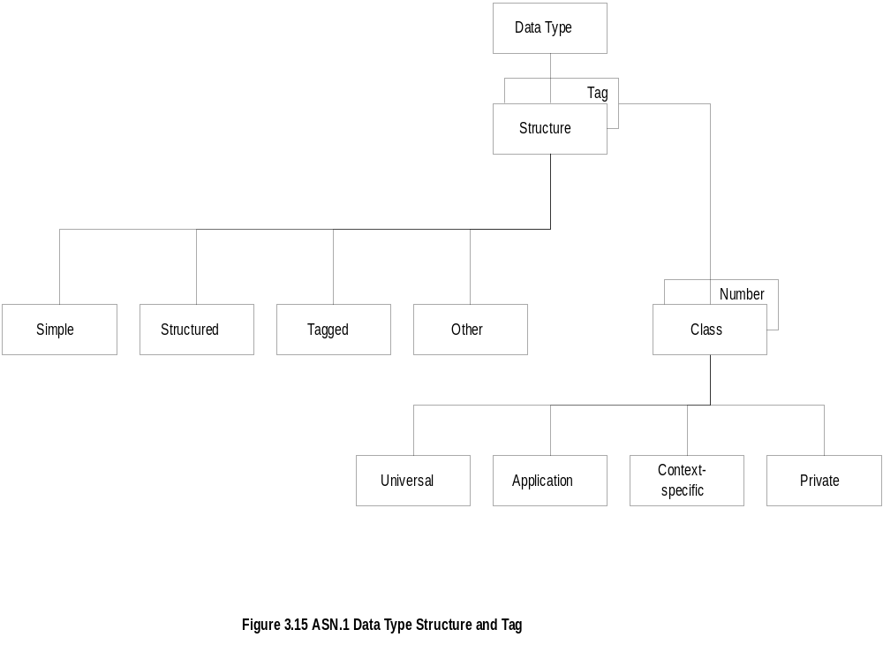
Chapter 3
Data Type: Structure & Tag
  Notes
Structure defines how data type is built
Tag uniquely identifies the data type
Network Management: Principles and Practice
© Mani Subramanian 2000
3-38

Slide 39
Chapter 3
Structure
Simple
  PageNumber ::= INTEGER
  ChapterNumber ::= INTEGER
Structure / Construct
  BookPageNumber ::=
  SEQUENCE
  {ChapterNumber, Separator, PageNumber
  Example: {1-1, 2-3, 3-39}
Tagged
  Derived from another type; given a new ID
  In Fig. 3-14, INTEGER is either universal or
  application specific
Other types:
  CHOICE, ANY
  Notes
BookPages ::= SEQUENCE OF { BookPageNumber}
or
BookPages ::=
SEQUENCE OF
{
SEQUENCE
    {ChapterNumber, Separator, PageNumber}
}
Network Management: Principles and Practice
© Mani Subramanian 2000
3-39

Slide 40
Chapter 3
Tag
Tag uniquely identifies a data type
Comprises class and tag number
Class:
  Universal - always true
  Application - only in the application used
  Context-specific - specific context in application
  Private - used extensively by commercial
  vendors
  Notes
Example:
BOOLEAN Universal 1
INTEGER Universal 2
research Application [1] (Figure 3.13)
product-based Context-specific under research [0]
Network Management: Principles and Practice
© Mani Subramanian 2000
3-40

Slide 41

Chapter 3
Enumerated Integer
  Notes
ENUMERATED is a special case of INTEGER
Example: RainbowColors(5) is orange
Network Management: Principles and Practice
© Mani Subramanian 2000
3-41

Slide 42

Chapter 3
ASN.1 Module Example
  Notes
Network Management: Principles and Practice
© Mani Subramanian 2000
3-42

Slide 43
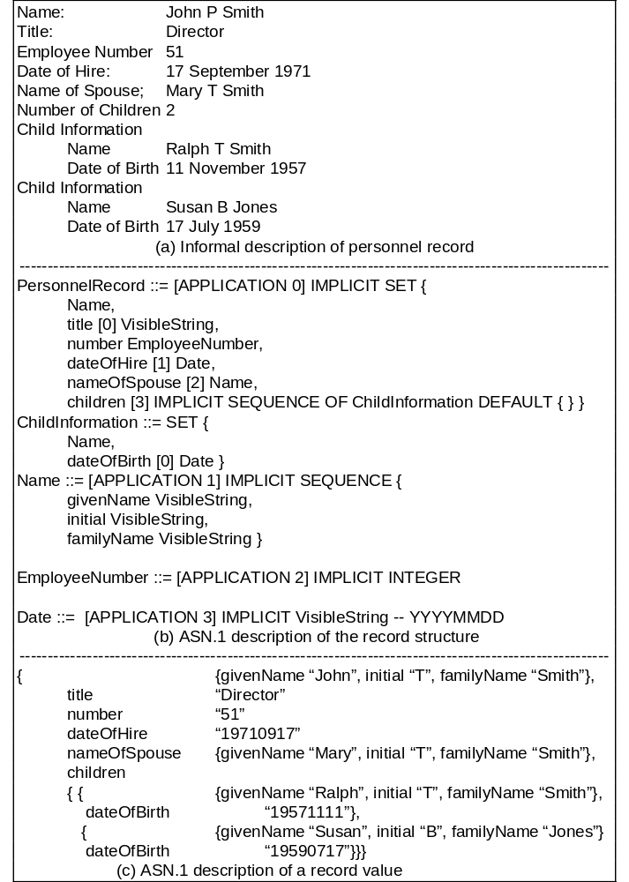
Network Management: Principles and Practice
© Mani Subramanian 2000
3-43

Slide 44
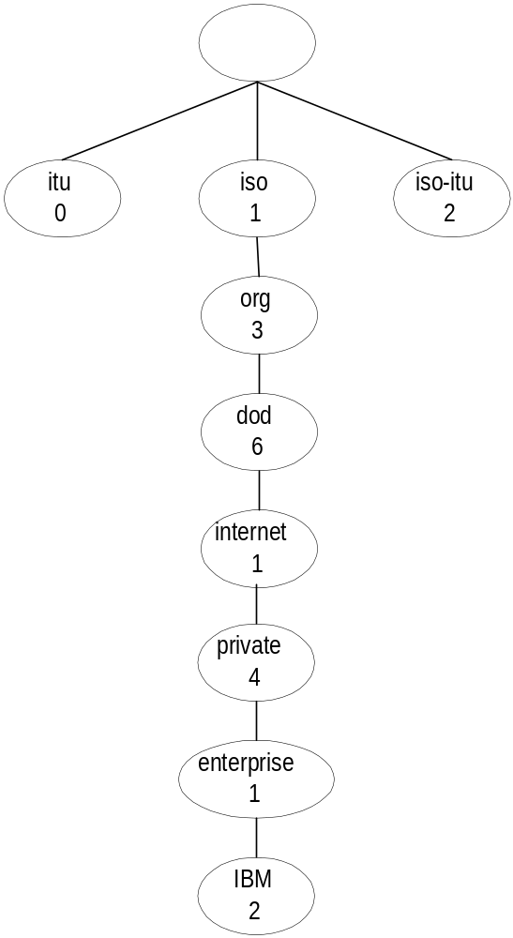
Chapter 3
Object Name
  Notes
internet OBJECT IDENTIFIER ::=
{ISO(1) ORG(3) DOD(6) INTERNET(1)}
Network Management: Principles and Practice
© Mani Subramanian 2000
3-44

Slide 45
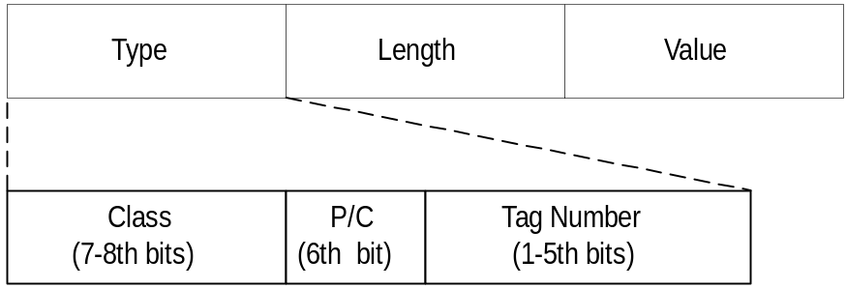

Chapter 3
TLV Encoding
  Notes
TLV Type, length, and value are components
of the structure
Network Management: Principles and Practice
© Mani Subramanian 2000
3-45

Slide 46
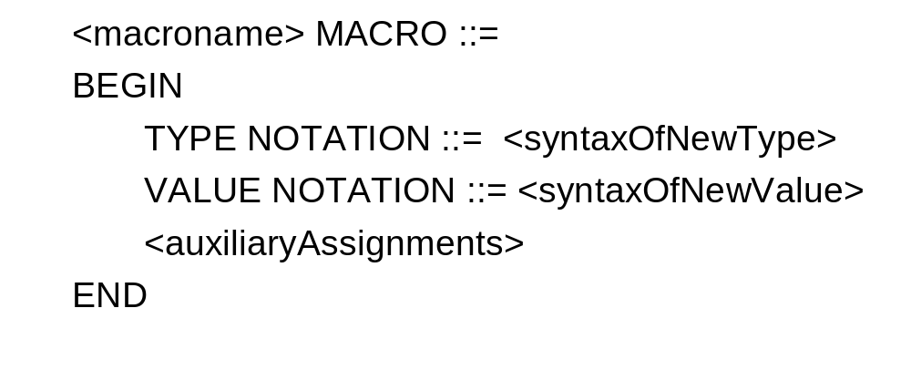
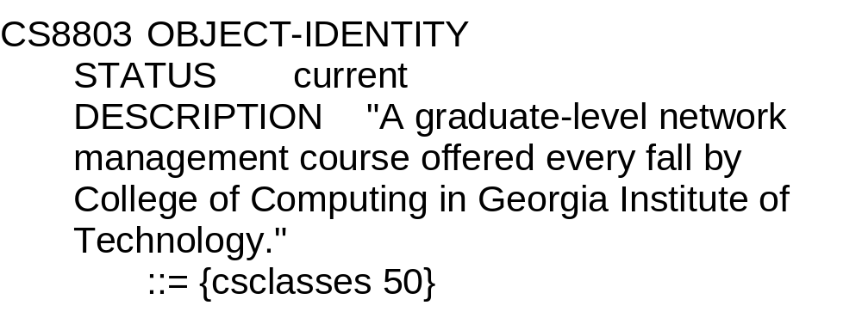
Chapter 3
Macro
Example:
  Notes
Macro is used to create new data types
Network Management: Principles and Practice
© Mani Subramanian 2000
3-46

Slide 47
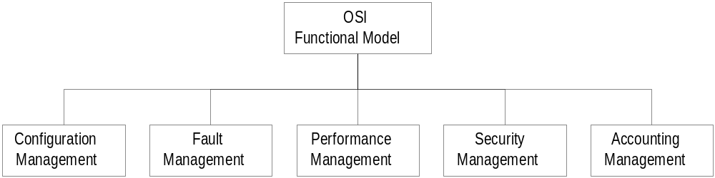
Chapter 3
Functional Model
  Notes
Configuration management
  set and change network configuration and
  component parameters
  Set up alarm thresholds
Fault management
  Detection and isolation of failures in network
  Trouble ticket administration
Performance management
  Monitor performance of network
Security management
  Authentication
  Authorization
  Encryption
Accounting management
  Functional accounting of network usage
Network Management: Principles and Practice
© Mani Subramanian 2000
3-47

